Slide 1
Compliance Basics for the Research Administrator
Sarah Johnson-Schlueter – Compliance Manager – College of Agricultural & Life Sciences

Slide 2
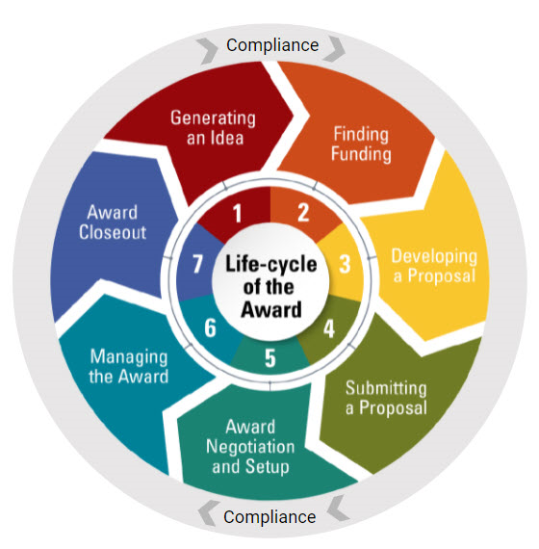
Compliance is Important
Notes:
What do you think of when you hear the word compliance?

Slide 3

What We Will Cover
The big three committees
  IACUC
  IBC
  IRB
PI Status
Outside Activity Reporting (OAR)
Required Trainings
Export Controls
Other Compliance Items

Slide 4
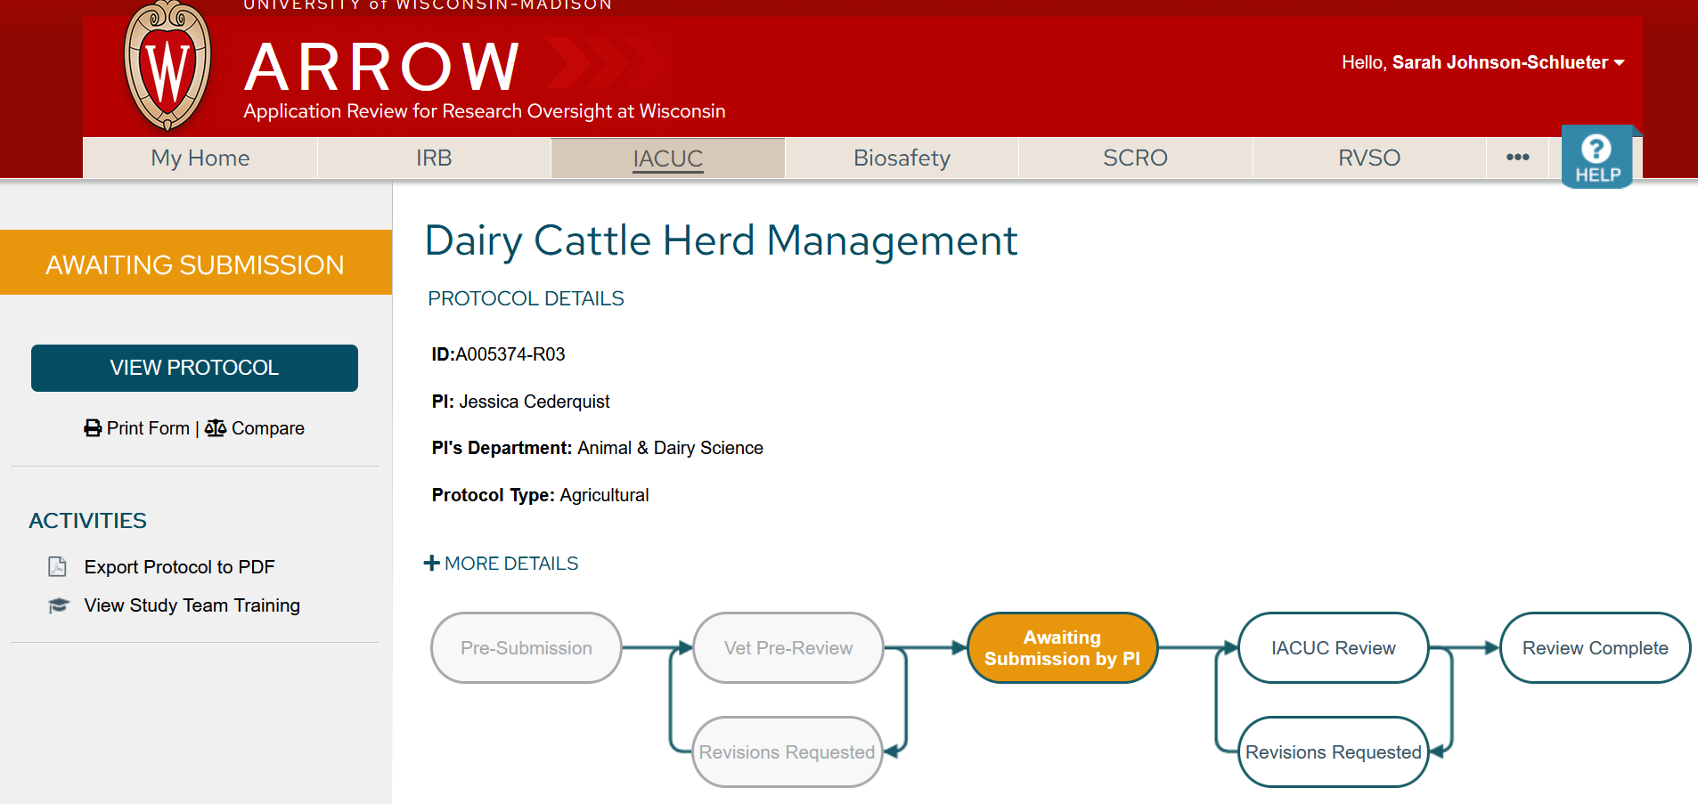
ARROW
Application Review for Research Oversight at Wisconsin
Animal use, biosafety, human subject research and other protocols are managed by the Principal Investigator in ARROW
Notes:
An online protocol management systems that looks and works similarly to RAMP.

Slide 5
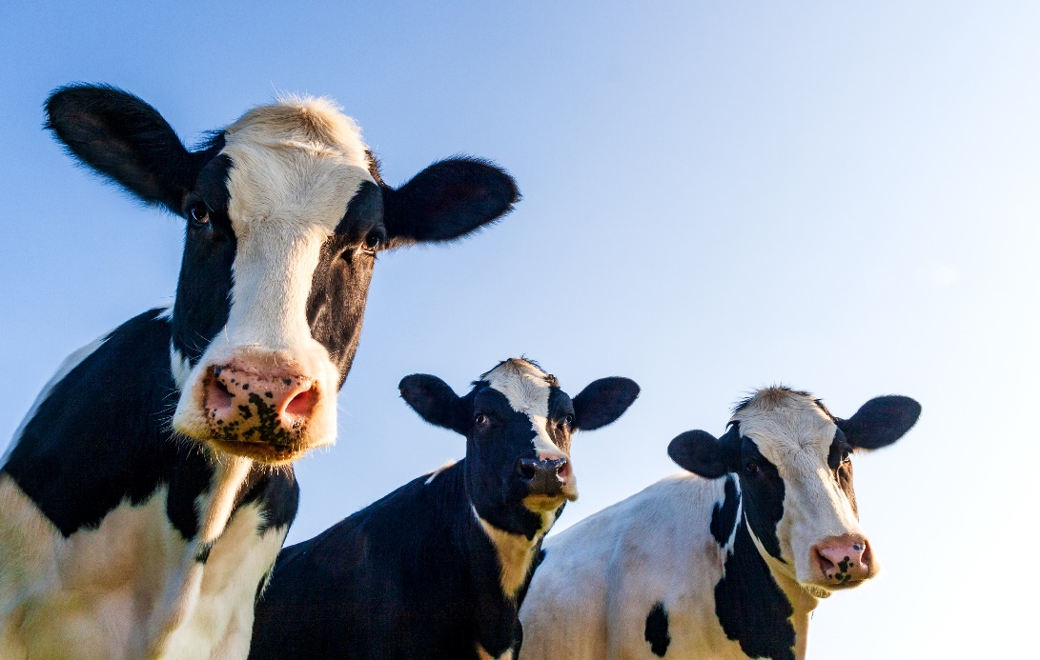
Institutional Animal Care & Use Committee (IACUC)
Approval required for direct use of vertebrate animals
  Research
    Biomedical
    Agricultural
    Wildlife
  Teaching
    Courses involving animals
      Animal & Dairy Sciences, Veterinary Medical Teaching Hospital, Medical Training
  Outreach
Notes:
NOTE: Research Animal Resources & Compliance (RARC) is separate from IACUC
- Provides IACUC and protocol support and administration, veterinary care, oversight, training, support etc.
-Biomedical: human clinical medicine, medical trials intended as models of human (not animal) diseases
-Agricultural: Improving animals’ use in production agriculture or trials intended to improve animal welfare
-Wildlife: Direct interaction or alteration of habitat or behaviors c
-Outreach: Community. Example –Association of Women Breakfast on the Farm (animal educational display)

Slide 6
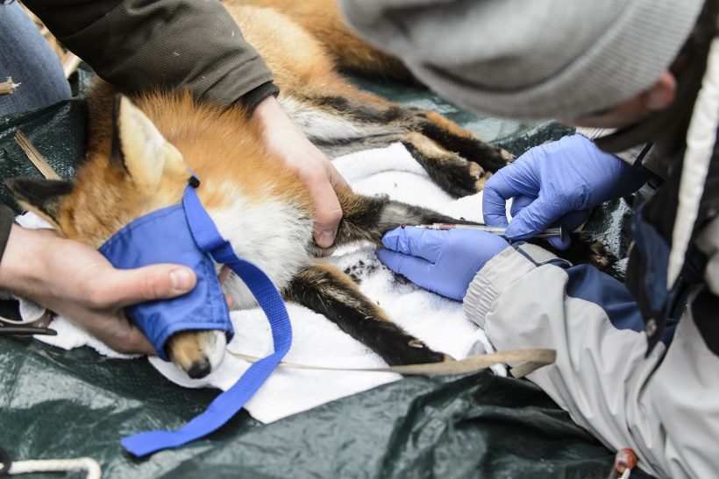
IACUC – Protocols
Required when using:
  LIVE vertebrate animals
    Mice, Rats, Fish, Birds, Cattle etc.
    Wildlife - Capture, Radio Collars, Feeding etc.
NOT required when using:
  Deceased animals/tissue
    Tissues obtained from a slaughterhouse, legal hunting
  Invertebrates
    Worms, fruit flies
  Wildlife
    Camera Traps, Vocalization Recordings, Passive Feces/Hair Collection etc.
Photo Credit: Jeff Miller
http://uwurbancanidproject.weebly.com/data-collection.html
Notes:
To determine need for an IACUC protocol, look for details in the Scope of Work/Methods/Approach.
All protocols are managed in ARROW - Application Review for Research Oversight at Wisconsin

Slide 7
IACUC – Protocol Review
Veterinary Prereview
Full Committee Review
  Assigned to monthly meeting for review by all members
Designated Member Review
  Two committee members and an Animal Research Safety representative
Veterinary Verification & Consultation (VVC)
  Administrative review of certain changes preapproved by IACUC and verified by veterinarian
  Speeds up some protocol amendments
Updates required annually and renewal required every 3 years
Notes:
IACUC meets only monthly.
Once submitted, committee is given 2 days to vote whether protocol is eligible for designated review. If anyone votes “no”, protocol goes to full committee.
Designated review can sometimes go more quickly because there is no need to wait for the monthly meeting.
Delays in protocol approval are often due to slow response by PI to answer questions/make requested changes.
VVC – https://policy.wisc.edu/library/UW-4132
- Anesthesia, analgesia, or sedation to referenced drugs and dosages for the species.
- Experimental substances, including a change in test compound, dose, or route of administration as long as the change does not result in a change in study objectives or greater pain, distress, or degree of invasiveness.
- Euthanasia to any method that is approved in the current American Veterinary Medical Association (AVMA) Guidelines for the Euthanasia of Animals.
- Duration, frequency, type, or number of previously approved procedures performed on an animal as long as the change does not result in greater pain, distress, or degree of invasiveness. For some procedures, different variations of the procedure can be approved (e.g., blood-draw type).
- Justified increase in previously approved animal numbers - policy UW-4131 Animal Program: Justification of Numbers.
- IACUC-approved housing or procedure space
- Source of OR disposition of animals.

Slide 8
Grant-Protocol Congruence Reviews
Required by
  DHHS, Public Health Service (PHS)
    NIH, CDC, FDA, Agency for Healthcare Research, etc.
  National Science Foundation (NSF)
  Other sponsors upon request (Rare)
Required for
  New awards
  Competing continuations
Notes:
-At first JIT request, only the protocol number and approval date are needed, NOT date of congruence. (‘Sponsor Review’ status)
-Request Congruence AFTER the proposal has been awarded or it’s known that it is likely to be funded.
-Sponsor requires it for the 2nd JIT request from a Grants Manager. (‘Changes Required’ status)
-It’s burdensome for PIs to complete congruence review for an award that doesn’t get funded, especially if they had to make protocol amendments.
-Request the review in the second JIT phase, or if you know the proposal is likely to be funded.

Slide 9
Congruence Reviews continued
Conducted by Research Animal Resources & Compliance (RARC)
  Principal Investigators (PIs) & Protocol Writers request review in ARROW protocol workspace
    Grant must have been added to the funding page first!
RARC issues a congruence letter to be sent with 2nd Just In Time (JIT) Request
Directions can be found at https://www.rarc.wisc.edu/protocols/request_grant_congruence.html
Notes:
- Generally fast turnaround
- Can take more time if grant and protocol are found incongruent and protocol amendments are needed
ARROW - Application Review for Research Oversight at Wisconsin

Slide 10

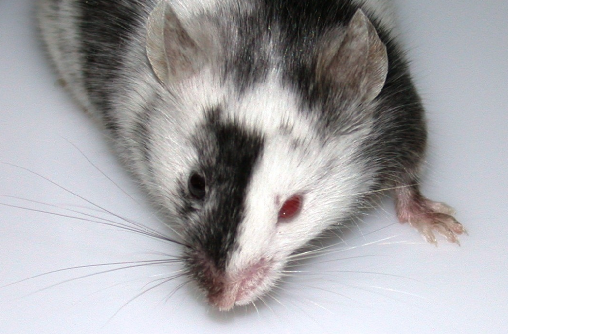




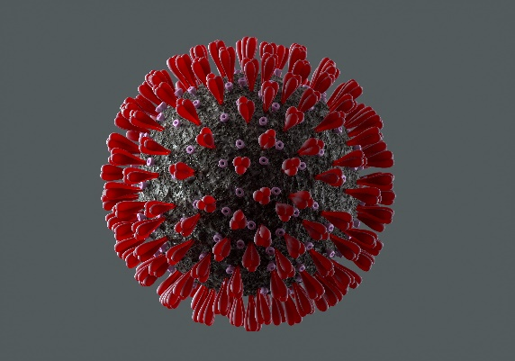

Institutional Biosafety Committee (IBC)
Bloodborne Pathogens
Transgenic Animals
Photo: International Society for Transgenic Technologies
Recombinant DNA
Large-scale Propagation
Disease-causing agents
Transgenic Plants
Photo Credit: WCIC
Biological Samples
Biological Toxins
https://ehs.wisc.edu/labs-research/biological-safety/biosafety-protocol-arrow/
Notes:
- IBC Approval required for:
Bloodborne Pathogens (BBP Plan)
Recombinant (transgenic) or synthetic DNA/RNA materials
Microbes and disease-causing agents (bacteria, viruses, fungi, prions, protozoa, and parasites)
Large scale propagation consisting of a volume greater than 10L or more in one vessel
Human cells and cell culture, organs or tissues, or biological samples
Non-human cells and cell culture, organ or tissues, or biological samples that are infectious, potentially infectious or recombinant
Animals: Transgenic, exotic, and/or grown in association with pathogens and/or recombinant materials
Plants: Transgenic, exotic, and/or grown in association with pathogenic or recombinant microbes and/or pathogenic or recombinant small animals (insects, etc.)
Biological Toxins

Slide 11
IBC Protocols
Required when using
  Human blood, cell lines, and other potentially infectious material
  Gene editing of plants, animals, bacteria etc.
    CRISPR, Agrobacterium, Lentivirus
  Pathogens
    Bacterial
    Viral
    Fungal
    Prions & Parasites
  Biological Toxins
Reviewed by 2 committee members & a biosafety specialist
  Then goes to full committee for a vote at the monthly meeting
Notes:
To determine need for an IBC protocol, look for details in the Scope of Work/Methods/Approach.
NOTE: The IBC meets only monthly to review and approve protocols, which can delay award setup. Protocols cannot be approved outside of the meeting as they can with IACUC designated review. (NIH Regulations)
-Organs, tissues, biological samples that could be infectious.
- Bacterial: E-coli, Streptococcus, human or animal gut microbiota
Viral: Influenza, COVID, Zika
Fungal – Blastomyces dermatitidis, Airborne toxic fungus that causes blastomycosis. Common in northern WI. Ringworm, Aspergillus (mold), Candida (yeast, causes trush)
Prions – Chronic wasting disease
Parasites- Cryptospordium spp, Giardia (food/waterborne)
Biological toxins: Poisonous substances produced by certain microorganisms, animals, and plants
- Botulinum Toxin (Botox) neurotoxin from Clostridium botulinum, Diphtheria (Corynebacterium diptheriae) and Pertussis (produced by Bordetella pertussis, whooping cough)

Slide 12

Institutional Review Board (IRB)
Human Subjects Research
  Develops or contributes to generalizable knowledge and
  Involves a living individual about whom an investigator
    Obtains and uses information or biospecimens through intervention or interaction with the individual
    Obtains, uses, studies, analyzes, or generates identifiable private information or identifiable biospecimens
Notes:
Research that contributes to generalizable knowledge and involves a living individual whom a researcher obtains and studies information/biospecimens through intervention/interaction or obtains and studies/generates identifiable private information or biospecimens.

Slide 13

Institutional Review Board (IRB)
Health Sciences IRB & Minimal Risk Research IRBs
Must review all research involving human subjects
Research cannot begin until a determination is reached
  Approval, Exemption, Not Human Subjects Research, etc.
Application Types
  Protocol Based (PBA)
  Non-Protocol Based (nPBA)
  sIRB
  Ceded
Notes:
-PBA - Health Sciences IRB: Reviews research protocols involving medical interventions or procedures where medical expertise is required for evaluation.
More than minimal risk studies - (clinical trials, physical interventions, drug or device studies, etc.)
-nPBA - Minimal Risk Research IRB: Reviews research protocols that present minimal risk to subjects, including medical interventions or procedures requiring medical expertise or knowledge of the health care setting and human participants research occurring within the social and behavioral sciences.
Minimal risk - (exempt or education research, data analysis, etc)
- sIRB – for studies with 2 or more sites and UW serves as primary reviewing IRB
Ceded - Used when relying on an external IRB
– UW IRB Approval is required even when the other institution holds their own
Think of as 2 stage process. UW must first approve ceding review, and the reviewing IRB must then issue an approval.

Slide 14
IRB Application Types
PBA
  For more than minimal risk studies
nPBA
  For minimal risk research
  Protocol Development Activity (PDA)
    Used for funding purposes only.
    Full approval or exemption must be obtained prior to start of human subjects work
RSP will require IRB approval letter for award setup when:
  1) IRB review has been ceded
  2) Approval status is “Certified”
Notes:
More than minimal risk studies:
Clinical trials
Biomedical studies with multiple physical interventions
Studies requiring review by the ICTR Scientific Review Committee (UW Institute for Clinical and Translational Research)
Non-exempt minimal risk studies where UW-Madison will serve as the reviewing IRB for 2-3 sites (excepting UnityPoint Health-Meriter)
Studies investigating a drug or device
Registry and repository studies
Minimal Risk Research
Exempt research and most education, social, and behavioral research
Studies that qualify for expedited review or full/convened board review
Health care records review studies
Statistical Data Analysis Center (SDAC) studies
Protocol Development Activities (PDA)
Training grant, umbrella grant, or core grant

Slide 15

IRB – Protocol Examples
Required for
  Clinical trials and trials investigating
    Vaccines, medications, medical devices, surgical procedures etc.
  Surveys & Questionnaires
    Include identifiable personal information (name, birth date, financial info etc.)
  Health care records reviews & data analysis
  Research involving identifiable biospecimens
    Blood, tissues, cells etc.
  Sensory Panels
Notes:
To determine need for an IRB review, look for details in the Scope of Work/Methods/Approach.

Slide 16
IRB – Tools
To help determine when an IRB protocol is needed use
  IRB worksheet #310- Human Research Determination
  https://uwmadison.app.box.com/s/y3oe7jenjvzff84bf7d6rja7st81j0y2
    Found at https://irb.wisc.edu/toolkit-library/worksheets/
  IRB QI/Program Evaluation Self-Certification Tool
    https://uwmadison.co1.qualtrics.com/jfe/form/SV_0uBiyxHZA7ygW9L?Q_JFE=qdg%22
    This tool allows study teams to make the decision about whether their project constitutes the definition of research under the Common Rule (45 CFR 46) independent of the IRB. The tool is designed to help determine whether the project constitutes research or whether it is quality improvement or program evaluation, such that IRB review isn’t required.

Slide 17
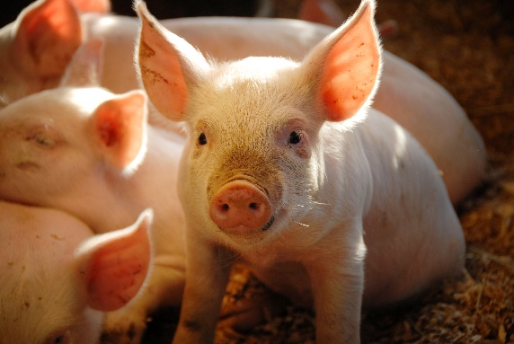

Other Compliance Review Questions
Stem Cell Research Oversight (SCRO)
  Approval for human embryos or embryonic stem cells, or human pluripotent stem cells in animals
Human Fetal Tissue research
  Requires IRB approval
Dual Use Research of Concern (DURC)
  Within the Biosafety question (3.b.)
Notes:
DURC
Research with agent that are reasonably anticipated to provide knowledge, information, products, or technologies that could be directly misapplied to pose a significant threat with broad potential consequences to public health and safety, agricultural crops and other plants, animals, the environment, materiel, or national security. (highly pathogentic Avian flu, Ebola virus)
Requires additional DURC committee review on top of IBC review.
Contact Christina Pier pier@wisc.edu 608-890-4951
Fetal tissue used to study things like
Alzheeimers, Parkinson’s, ALS
Cancer
Epilepsy
Birth defects
Heart disease and failure
Organ transplants
Vaccines

Slide 18
Is A Protocol Needed For that?
A soil science researcher is studying soil quality after planting various crops and grazing cattle on the plots.
A plant scientist is editing the genes of corn and growing it in a greenhouse to collect data.
A sociologist sends out a survey to collect data on television watching habits of children.
A surgeon is using gene edited pigs to study heart disease.

Slide 19
PI Status for Sponsored Projects
PI Status for Grants
  Tenured or tenure-track faculty
  Employees with Research Professor track titles or Permanent PI status
  Other academic staff may serve as PI on proposals and awards by requesting Limited PI Status on a project-by-project basis or by requesting Permanent PI Status
    Instructions & Information - research.wisc.edu/compliance-policy/principal-investigator-status
Notes:
-Research Professors must apply for and acquire Permanent PI status in order to obtain access to VCRGE Research Committee funding

Slide 20
PI Status Other
IACUC - policy.wisc.edu/library/UW-4114
  University PI Status, Morgridge Institute for Research (MIR) Approved PIs, those granted approval by IACUC by filing request form
IBC - policy.wisc.edu/library/UW-6081
  UW–Madison tenure track faculty, Research Professors (all levels), or academic staff that have been granted Permanent PI Status
  Other as approved by IBC by filing request form
IRB - https://policy.wisc.edu/library/UW-4063
  Appropriate appointment and performing relevant research within the scope
  Others as approved by IRB by filing request form
Notes:
Each of the 3 committees has their own policy. Similar with differences.

Slide 21
Adding Sponsored Projects to Protocols
PI must add the project to the funding page of ARROW protocol(s)
  For New Grants, Competing Continuations
  Add in the Primary Funding section
  If protocol is still active, information should transfer to NCE’s, Modifications, IF the compliance questions are answered appropriately.
For non-funded agreements (e.g., In-MTAs)
  Approved protocols required but do not need project added
Fee for Service – best practice
  Add to approved protocol(s) in a generic manner
    Leave Award # Blank
    Add generic title to describe the work
    Add a project ID set-up to encompass the work
    List Sponsor as “Multiple Donors”
Notes:
In ARROW protocol: Project Info will auto populate when PI searches Project ID, title, etc. in ARROW
If added under Other Funding, the information will not translate into the RAMP record
- Continuations, No Cost Extensions – as long as project remains the same, no need to add to protocol
- Out-MTAs, Master Agreements, DUA, CDA will not require protocols (generally) –No scope of work

Slide 22
Adding Protocol Information in RAMP
After the PI has added the RAMP record to their protocol, the information automatically populates into the Compliance Review smartform.
  Associated question(s) must be answered ‘Yes’
Notes:
Funding added in the ‘Other Funding Sources’ section of the protocol will not populate into the RAMP Compliance Review page. Funding added in the ‘Primary Funding Sources’ section will.

Slide 23
Adding Information in RAMP continued
Compliance Specialist, PI, Research Administrator etc. will upload to attachments.
  Congruence Verification (when applicable)
  IRB Letter (when applicable)
Approval Dates
  Required protocol approvals, trainings, and reports must be in date at time of award setup.
Notes:
Common question: What if the protocol expires during award period?
- Protocol renewals are handled by the respective protocol office. Once we’ve assured the sponsor of protocol approval, it’s on the institution (committees & PIs etc.) to ensure protocols remain in date.

Slide 24
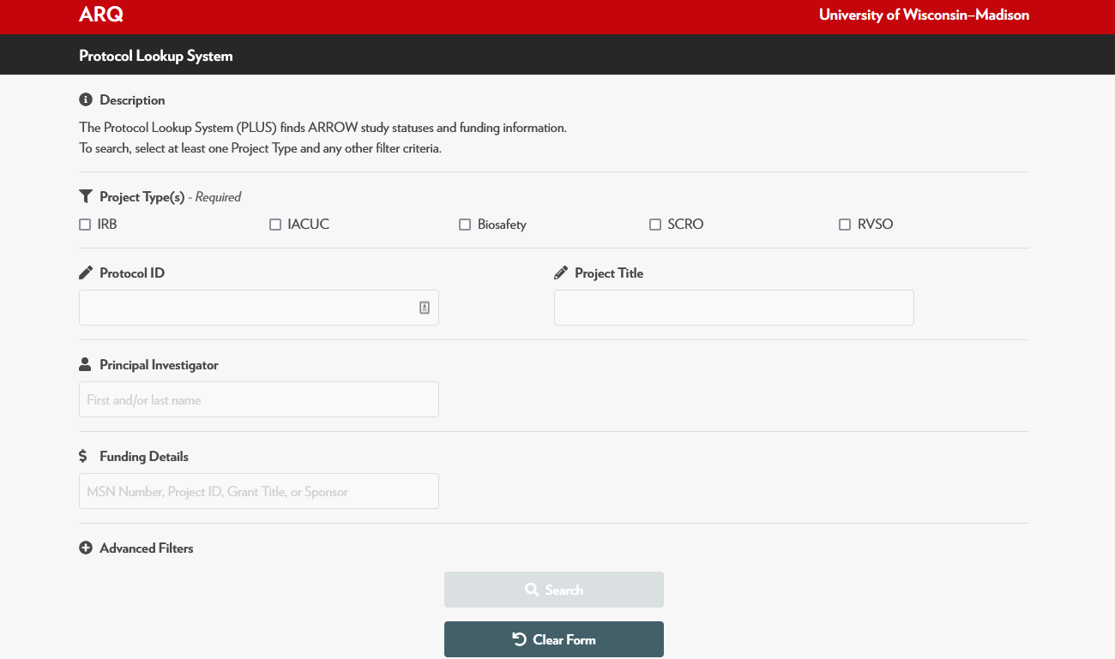
Protocol Lookup System (PLuS)
https://apps.research.wisc.edu/ARQ/Plus/
Notes:
Shows protocol number, dates, and projects/funding that has been added.
When searching in PLuS, if a project has been added to the “Other Funding Sources” section of the protocol you will not be able to find it when searching by ‘Funding Details’ (MSN, FP, or AWD number). Search by PI or Protocol number instead.

Slide 25
Outside Activities Reporting (OAR)
Method for reporting relationships having potential for conflict of interest
Required for anyone listed on a sponsored project
  Annually by April 30th
    And Within 30 days of
      acquiring a new financial interest
      a change to an existing financial interest
    At time of application for federally funded research
Notes:
UW rules, policy, and federal regulations require we ensure research is not biased in design/conduct/reporting, and ensure protection of human subjects by requiring disclosure and review and management of certain outside activities.
Financial conflict of interest (FCOI)- a significant financial conflict of interest that could directly and significantly affect the design, conduct, or reporting of federally funded research or research involving human subjects.
Who Submits
All faculty regardless of appointment.
Academic staff with > 50% total appointments.
Anyone responsible for design, conduct, or reporting of federally funded research.
Anyone involved in human subjects research, regardless of the source of funding.
Collaborators, subrecipients/subcontractors on a UW-Madison research project from an institution that does not have a COI program that complies with federal regulations and meet criteria 3 and 4 above.
Anyone with an active COI Management Plan.
Associated with this is Conflict of Commitment (CoC)
Policy for managing a type of conflict of interest that may occur when outside professional activities interfere with an employees UW obligations.
https://policy.wisc.edu/library/UW-1075

Slide 26
Required Trainings
Conflict of Interest (COI)
  Required for anyone listed on a federally sponsored research project or human subjects (IRB) protocol
    canvas.wisc.edu/enroll/D9DRHR
Responsible and Ethical Conduct of Research (RECR)
  Required for
    NSF
    USDA-NIFA
    USDA-NIFA Capacity (142) Awards
    NIH (Requirement included in grant application)
canvas.wisc.edu/enroll/EET6NH
Notes:
NSF - Beginning August 1, 2023, all UW–Madison principal investigators, co-investigators, faculty, key persons, postdoctoral researchers, graduate students, and undergraduate students supported by NSF funding must take the Responsible Conduct of Research (RCR) course in Canvas. Those that complete training prior to July 31, 2023 will have satisfied their training requirement until they receive an email indicating they must re-certify their training.
National Institute of Food and Agriculture (NIFA) - UW–Madison, principal investigators, co-investigators and participants supported by a USDA NIFA award must take the "Responsible Conduct of Research" course including, but not limited to, undergraduates, graduate students, postdoctoral researchers, and sub-recipient participants.
USDA NIFA Capacity (142) Awards: All UW–Madison active principal investigators, co-investigators, undergraduate students and graduate students supported by 142 Hatch funds, must receive responsible conduct of research course in Canvas.
National Institutes of Health: Requires a minimum of eight hours of face-to-face training every four years for trainees, fellows, participants and scholars supported by some types of D, F, K, R, T, and U awards. At UW–Madison, the plan for meeting these requirements is included in the grant application.

Slide 27
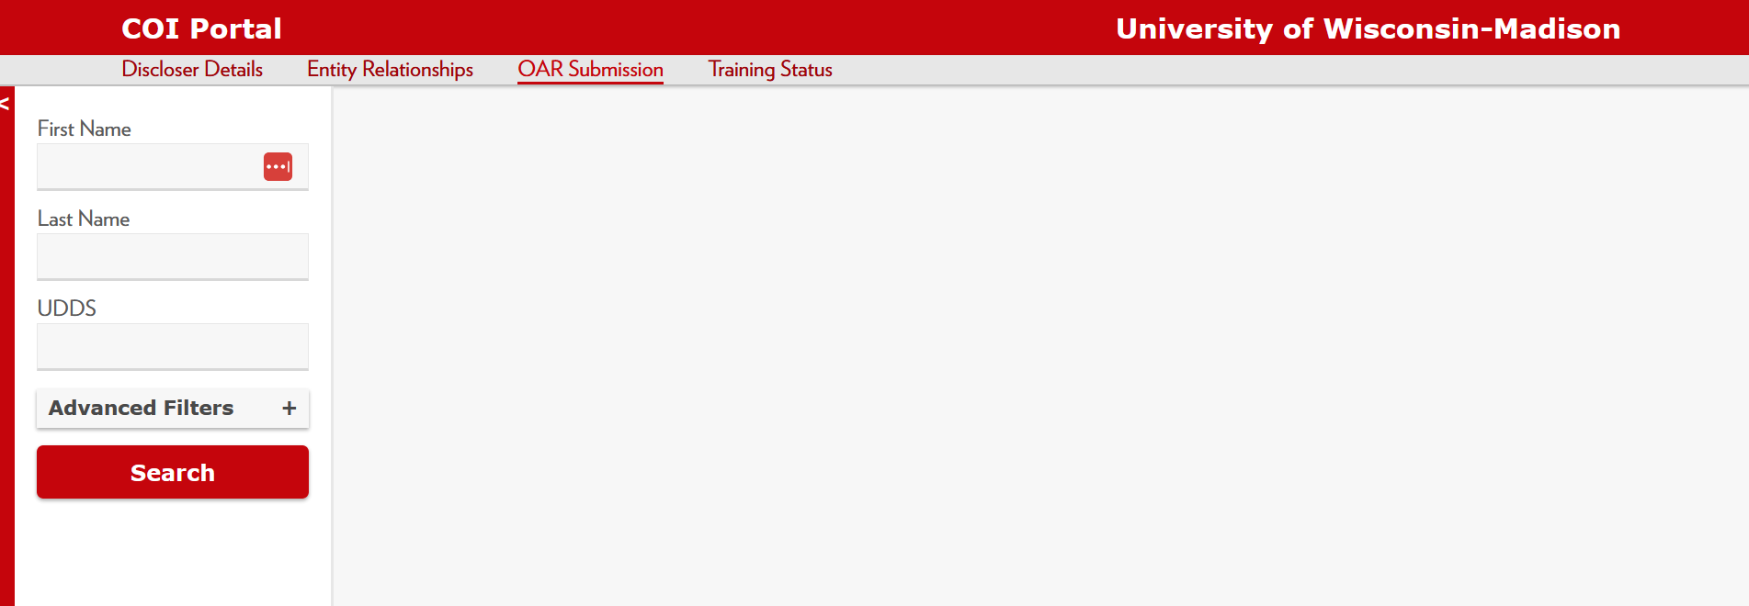
COI Portal
Tool to determine OAR Status and COI Training
  https://apps.research.wisc.edu/COI/Lookups/OAR

Slide 28
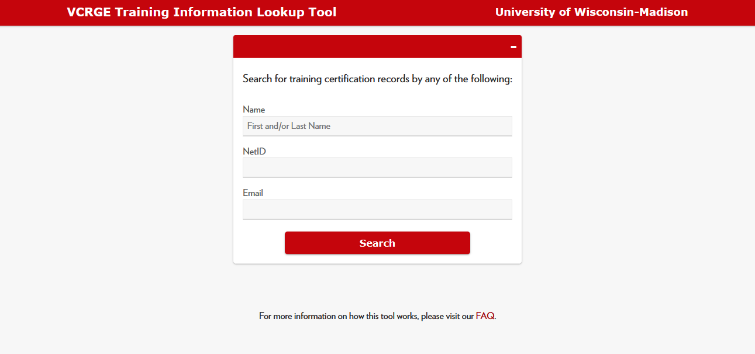
VCRGE Training Information Lookup Tool
Search tool for: COI, RCR, and other Trainings
https://apps.research.wisc.edu/TILT

Slide 29

Export Controls
Federal laws & regulations control distribution of certain commodities, technologies, information and data to foreign persons or organizations
  For national security
    Military and dual use products, technology
  For economic purposes
    Sanctions, Restricted Parties and Specially Designated Nationals Lists
Notes:
Export: Sending or taking anything out of the United States in any manner.
Shipping – commercial shippers or hand-carry
Verbal transfer of technical data (i.e., phone, Zoom, Teams)
Electronic transfer of technical data (i.e., e-mail, fax, text, social media)
Does not include mere travel/personal knowledge of technical data
-Deemed Export:
Transfer of technology, information, or data to a foreign person within the US. Can be verbal or visual disclosure.
- We are required to comply with U.S. Export Control laws and regulations, including the International Traffic in Arms Regulations (ITAR), Export Administration Regulations (EAR) and Foreign Asset Control Regulations (FACR).
-Non-compliances with these regulations can lead to severe penalties.
-Affects research we can conduct, hiring, information and items we can ship/share, and where, collaborations/sponsors
-Specially Designated Nationals List: Persons and organizations with which we cannot conduct business. (Terrorist organizations or those with security concerns)

Slide 30

Export Controls – What to Look For
Contract clauses – may remove the research exemptions
  Publication restrictions
  Personnel restrictions
  Export control paragraph
  NDAs for technical information
  Controlled Unclassified Information (CUI)
Notes:
Look for anything that does or could restrict publication of the research.
When research exemptions removed, we are subject to export control regulations.
- Publication restriction: requires approval from the sponsor for any publication resulting from the research. OVCRGE waiver required to accept such projects.
- Personnel restriction: sponsor does not allow the participation of persons from certain foreign countries.
Contact the export control office.

Slide 31
Export Controls – What to Look For
Some DoD funding
  If developmental rather than fundamental research, it is subject to export controls.
International shipping & travel
Purchases from a foreign supplier
Service work not considered research
  Unknown substance analysis
  Manufacture for commercial devices
  Providing materials for research outside UW
Notes:
DoD: Funding strings 6.1 and 6.2 (budget activities 1 and 2) are for basic and applied research, and are typically considered fundamental. All other research would be developmental and subject to export controls.

Slide 32
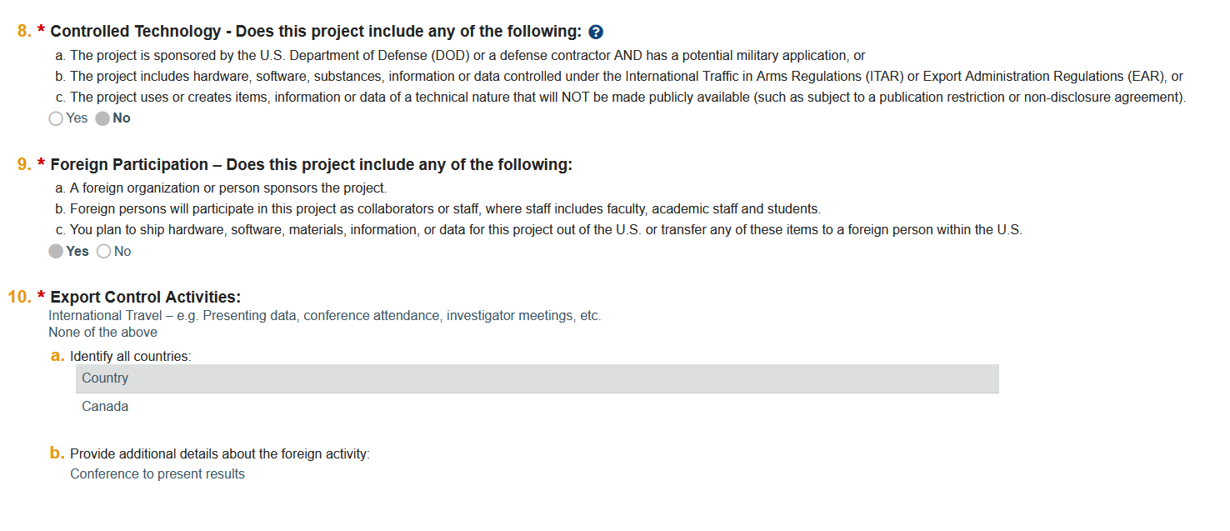
Export Controls – RAMP
PI answers questions 8, 9, & 10 on the Compliance Review smartform in RAMP
Activities with potential implications
  Traveling, Shipping, Collaborating Abroad
  Working with
    Controlled items
    Restricted countries
Export Control Office
research.wisc.edu/integrity-and-other-requirements/export-control
Notes:
We are required to comply with U.S. Export Control laws and regulations, including the International Traffic in Arms Regulations (ITAR), Export Administration Regulations (EAR) and Foreign Asset Control Regulations (FACR).
controlled items (examples include lasers, thermal imaging cameras, select agents, space qualified equipment and encryption.
Grant or other contracts with an export control clause, publication restriction or personnel restriction

Slide 33

Export Controls – Foreign Person
Definition:
  Someone who is not:
    A U.S. citizen or national of the U.S.,
    A permanent resident (green card holder) of the U.S., or
    Lawfully admitted to the U.S. for refugee, asylum or amnesty reasons
Notes:
Question #9 is in the system primarily to ensure that UW–Madison complies with Export Control and research security regulations. It also helps us address compliance with various sponsor prior approval requirements or other terms and conditions.

Slide 34

Other Compliance Items
Research Vehicles Safety Oversight (RVSO)
  For autonomous vehicles: drones etc.
  Pilot and Flight applications must be submitted in ARROW
Hemp Research
  USDA Licensure Required – College Specific
DEA Controlled Substances in Research
  State Licensure and Federal DEA Registration Required – PI contacts RARC
Bayh-Dole Act: https://research.wisc.edu/bayhdole/
Effort Reporting
Notes:
Bayh-Dole Act
Also called the Patent and Trademark Law Amendments Act
Deals with intellectual property arising from federally funded research
Allows universities/businesses to pursue ownership of inventions (rather than assigning to government)
All employees and graduate students are required to sign an agreement to comply or UW may not own the inventiions/patents go.wisc.edu/bayhdole
Applies to all funding from May 2018 on.
Not yet required for sponsored project setup
Effort
- Must be reported and certified for anyone receiving salary support from a sponsored project or who expends committed effort on a sponsored project.
RSVO
- For autonomous vehicles: drones etc.
- Pilot and Flight applications must be submitted in ARROW
DEA
– PI contacts RARC
Hemp
- USDA Licensure Required – College Specific

Slide 35
Compliance Hold-Ups
There is no approved protocol to cover the work
  New protocols and some major amendments can take 30 days or more for approval
The protocol was added under Other Funding rather than Primary Funding
The protocol is in the amendment, renewal, or submission phase in ARROW
  Projects cannot be added to the funding page
OAR or COI trainings out of date or incomplete
Notes:
Committee meetings usually occur only Monthly. There are regulations surrounding giving members set number of days to vote etc.
A new OAR must be on file by April 30th each year.
COI Training expires after 3 years and must be retaken.

Slide 36
Contacts
IACUC – iacuc@rarc.wisc.edu
IBC – Andrea Ladd andrea.ladd@wisc.edu
IRB – asktheirb@wisc.edu
COI
  Your Department/Division: research.wisc.edu/kb-article/?id=32881
  COI Office: coiprogram@research.wisc.edu
Your Department/Division Compliance Manager or Specialist
  CALS – Sarah Johnson-Schlueter – Sarah.JohnsonSchlueter@wisc.edu
Notes:
Your Department/Division Compliance Specialist

Slide 37
Resources
ARROW – arrow.wisc.edu
RARC – www.rarc.wisc.edu
IRB – irb.wisc.edu
OAR – oar.wisc.edu
COI Training – research.wisc.edu/compliance-policy/outside-activities-reporting/training
UW Conflict of Interest Policy – policy.wisc.edu/library/UW-4001
Export Control - https://research.wisc.edu/integrity-and-other-requirements/export-control/

Slide 38
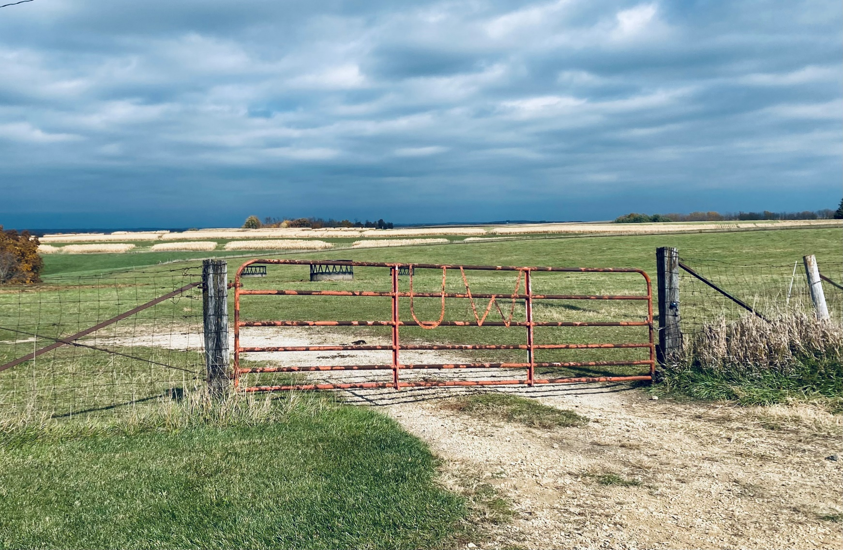
Thank You!

